Slide 1
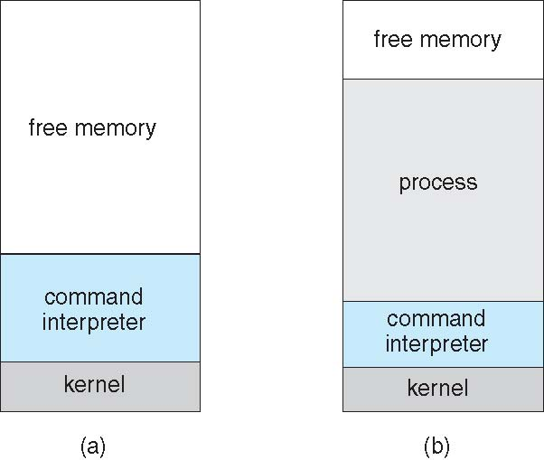
Example: MS-DOS
Single-tasking
Shell invoked when system booted
Simple method to run program
No process created
Single memory space
Loads program into memory, overwriting all but the kernel
Program exit -> shell reloaded
At system startup running a program

Slide 2
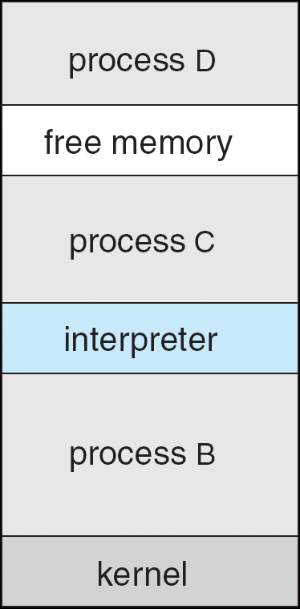
Example: FreeBSD
Unix variant
Multitasking
User login -> invoke user’s choice of shell
Shell executes fork() system call to create process
Executes exec() to load program into process
Shell waits for process to terminate or continues with user commands
Process exits with:
code = 0 – no error
code > 0 – error code

Slide 3
Operating System Structure
General-purpose OS is very large program
Various ways to structure ones
Simple structure – MS-DOS
More complex -- UNIX
Layered – an abstrcation
Microkernel -Mach

Slide 4
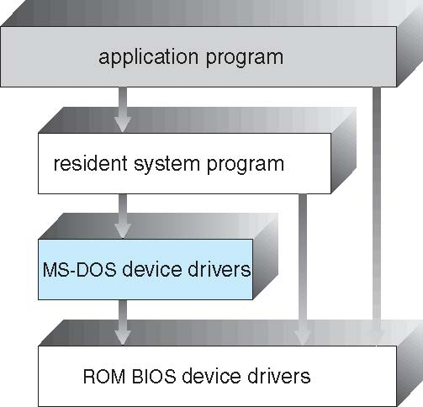
Simple Structure -- MS-DOS
MS-DOS – written to provide the most functionality in the least space
Not divided into modules
Although MS-DOS has some structure, its interfaces and levels of functionality are not well separated

Slide 5
Non Simple Structure -- UNIX
UNIX – limited by hardware functionality, the original UNIX operating system had limited structuring. The UNIX OS consists of two separable parts
Systems programs
The kernel
Consists of everything below the system-call interface and above the physical hardware
Provides the file system, CPU scheduling, memory management, and other operating-system functions; a large number of functions for one level

Slide 6
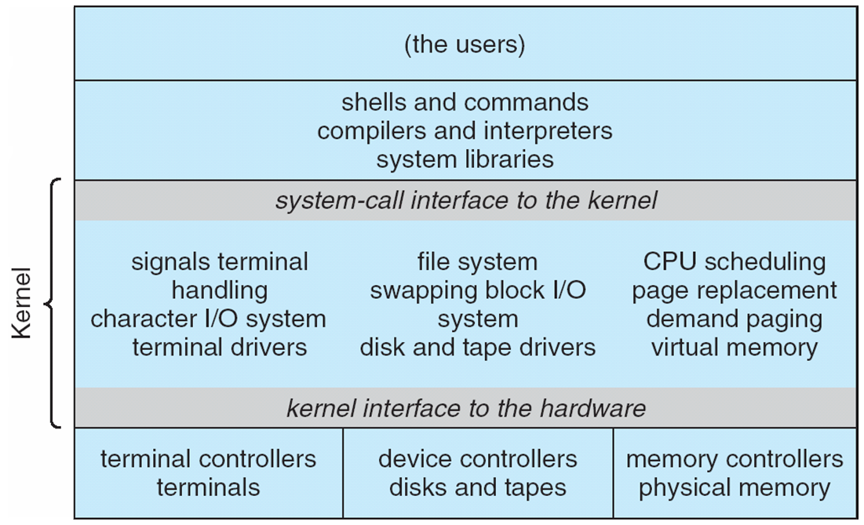
Traditional UNIX System Structure
Beyond simple but not fully layered

Slide 7
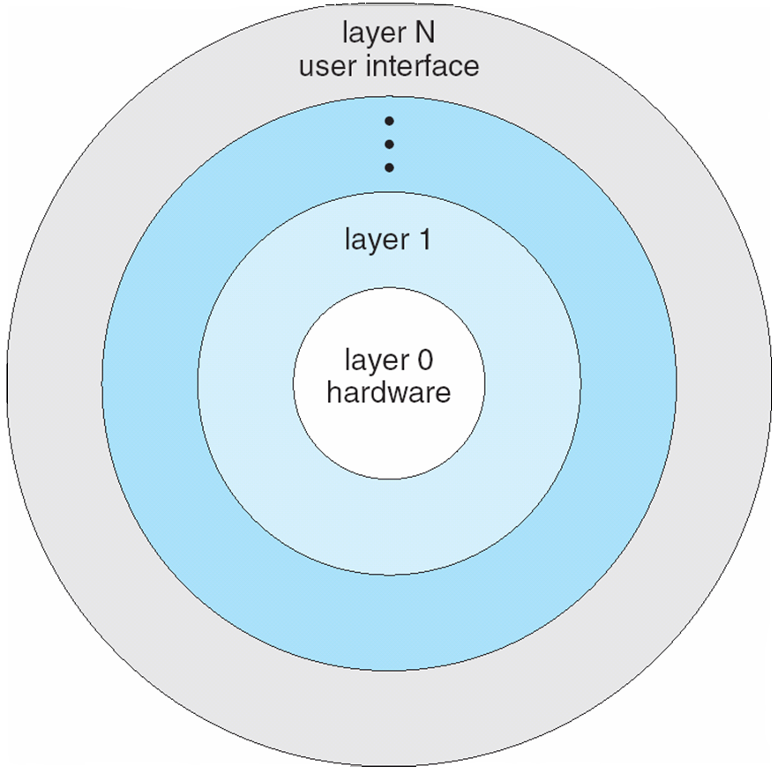
Layered Approach
The operating system is divided into a number of layers (levels), each built on top of lower layers. The bottom layer (layer 0), is the hardware; the highest (layer N) is the user interface.
With modularity, layers are selected such that each uses functions (operations) and services of only lower-level layers

Slide 8
Microkernel System Structure
Moves as much from the kernel into user space
Mach example of microkernel
Mac OS X kernel (Darwin) partly based on Mach
Communication takes place between user modules using message passing
Benefits:
Easier to extend a microkernel
Easier to port the operating system to new architectures
More reliable (less code is running in kernel mode)
More secure
Detriments:
Performance overhead of user space to kernel space communication

Slide 9
Microkernel System Structure

